Slide 1
Mathematics for ML

Slide 2
Maximizing Efficiency
In this presentation, we will explore the potential of mathematical models and algorithms to maximize efficiency in various fields. Let's delve into the world of mathematical optimization
Optimization is the process of finding the best solution from all feasible solutions.
It involves maximizing and minimizing an objective function while satisfying constraints. Through mathematical modeling and analysis, we can achieve optimal outcomes in diverse scenarios

Slide 3
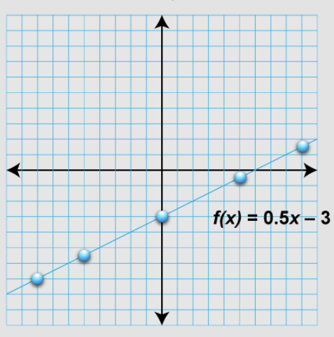
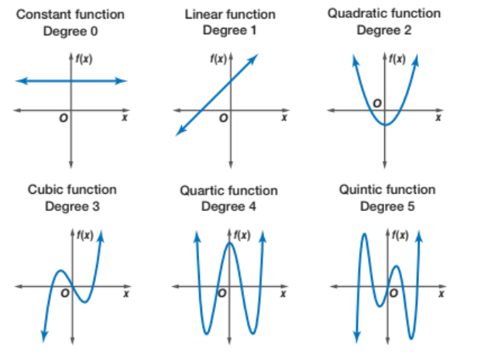
Linear Programing
Linear programming is a powerful tool for optimizing resource allocation and decision-making. By formulating problems into linear equations and inequalities, we can find the most efficient way to allocate resources and maximize profits.
If your data points are not linear then we are using polynomial function

Slide 4
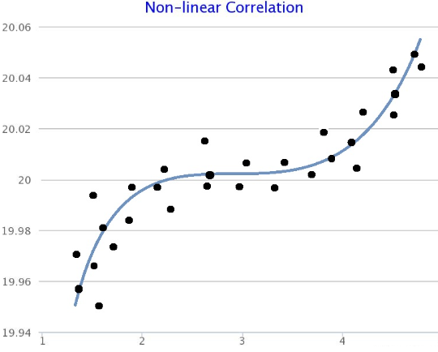
Non Linear Optimization
Nonlinear optimization extends the scope of optimization to problems with non linear relationships. It is essential for addressing complex real-world problems and achieving optimal solutions in diverse domains such as engineering, finance, and data analysis

Slide 5
Integer Programming
Integer programming deals with decision variables that must take on integer value. It is crucial for solving optimization problems with discrete decision-making and is widely used in supply chain management, scheduling, and network design

Slide 6
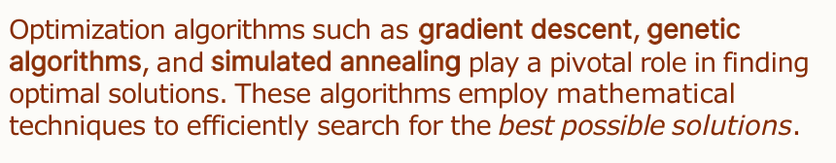
Optimization Algorithms

Slide 7
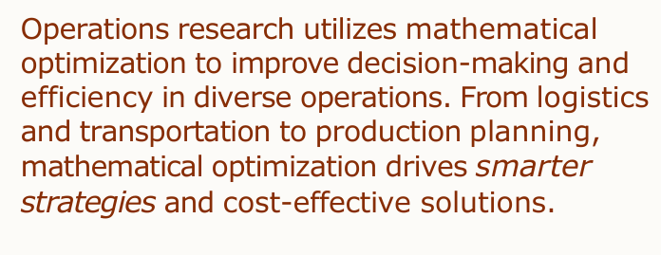
Applications Research in Operation Research

Slide 8
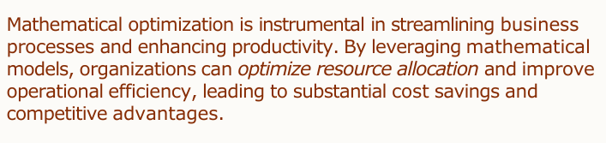
Optimizing Business Process

Slide 9
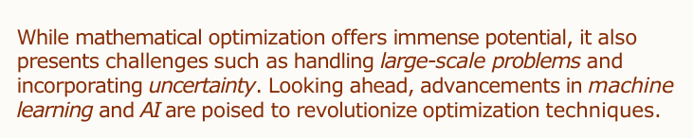
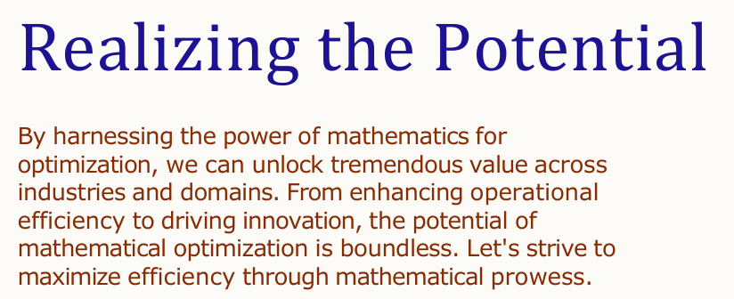
Challenges and Future Trends

Slide 10
Key Takeaways
Mathematical optimization enables maximizing efficiency and achieving optimal solutions.
2. Various techniques such as linear programming, nonlinear optimization, and integer programming offer versatile problem-solving capabilities.
3. Future advancements in AI and machine learning hold promise for revolutionizing optimization

Slide 11
Gradient Descent
Gradient descent is a widely used optimization algorithm in machine learning and deep learning that iteratively minimizes a cost function by moving in the direction of the steepest descent, effectively finding the minimum of the function.
Like F(X) = aX1 + bX2 + C
X1 and X2 are features means data columns, a and b are weights
The goal of machine learning is predict this function Initially we assume that my function is linear and know the value of X1 and X2 and get the value of a, b and c
So on the basis of that we can find out the value of function Y
Here problem is a and b are unknown, so if we can form a error function and Y is actual value
So I can differentiate to find the minimum value of that error function

Slide 12
Gradient descent is a widely used to optimize the value of parameter
Like my function Y have a and b are parameter which have a – α (alpha) and b- α and the minimum value at which your first derivate is 0 for a and b function that value is minimum value. Differentiation is nothing but slope and alpha is step size or learning rate
Analogy behind it is the loss function that we want to minimize
Gradient descent is iterative search algorithms
Iterative means you are doing the steps multiple time. You do until you reaches the a value which is not changing. It will not change when this value is tend to 0

Slide 13
In case of Euristic approach or rule based approach we know the input and process and will find the output
In machine learning problem we have idea about input and output but process or formula not known
If I can predict the formula for machine then when I have new input will easily find output value and that is our goal.
Let’s assume f(x) = aX1 + bX2 + C where X1 and X2 are feature value and a b c are my coefficient so we have to find out the coefficient
To find the error of prediction value, Where error , e = y - ŷ
Where Y is the actual value and ŷ is predicted value
Here, Predicted value is f(x) = aX1 + bX2 + C = ŷ1 and you can find the same thing for ŷ2 and take summation and this is your total error
So find such value of a b and c so that error is minimum

Slide 14
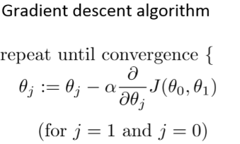
There are two ways 1) Using differentiation means f’(x) = 0 where value of x is either minimum or maximum that process is called normalization and other way is 2) Gradient Descent
Derivative in below equation give you direction and alpha will give you step
You will do till value of theta will not change w.r.t derivative function means that term will become 0. you do this things iteratively so that is the value is your optimize value
So that‘s how you will find the value of a b and c and can put into the function

Slide 16
Learning Rate

